Slide 1
Configuration Guide
(IDE – SQL Explorer Plug-in 3.5.0 RC8 on Eclipse 3.5)
2009. 07.22
CODELABOR
Shin Sang Jae (codelabor@gmail.com)

Slide 2
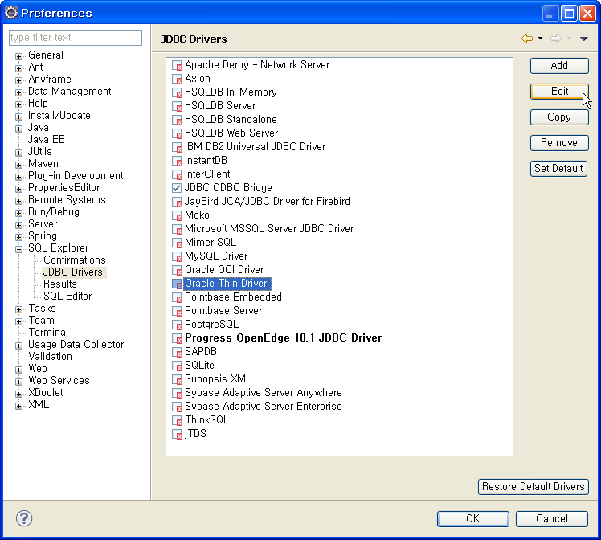
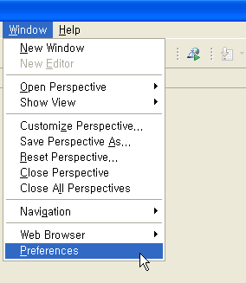
SQL Explorer
Preferences
Menu
  Window > Preferences
SQL Explorer
  JDBC Drivers > Oracle Thin Driver

Slide 3
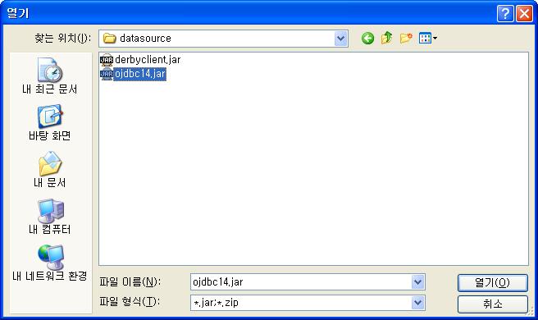
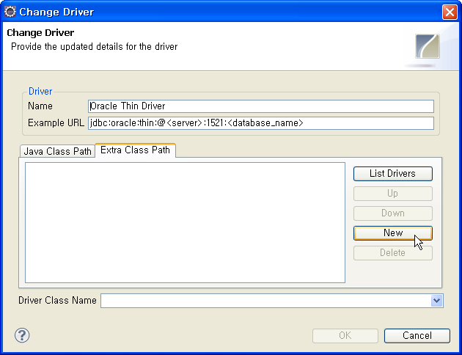
SQL Explorer
Preferences
Extra Class Path Tab
  Click New Button
File Chooser
  Select ojdbc14.jar

Slide 4
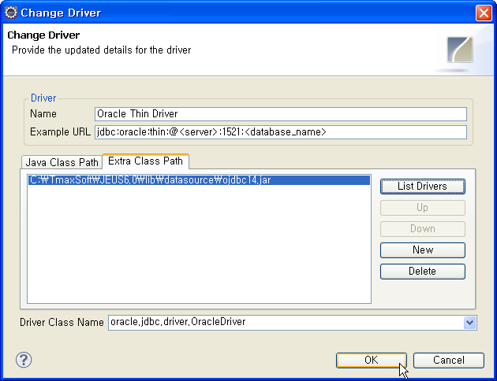
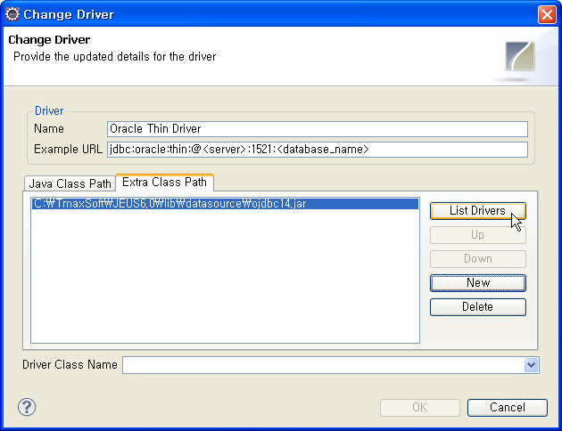
SQL Explorer
Preferences
Extra Class Path Tab
  Click List Drivers Button
Driver Class Name
  Oracle.jdbc.driver.OracleDriver

Slide 5

SQL Explorer
Preferences
Oracle Thin Driver Enabled

Slide 6
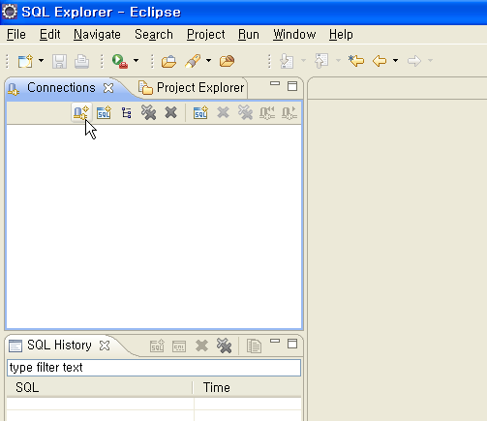
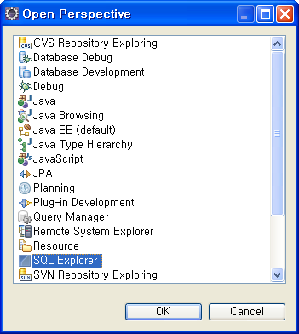
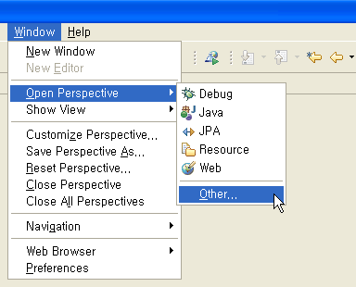
SQL Explorer
Perspective
Menu
  Window > Preferences
Perspective
  SQL Explorer
Connectinos Pan
  Click Create New Connection Icon

Slide 7
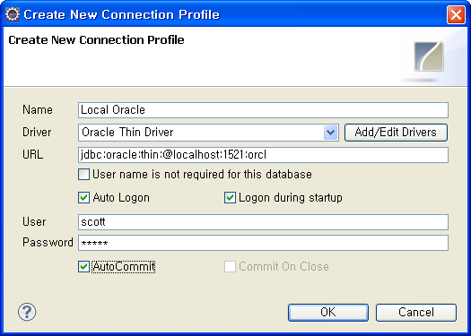
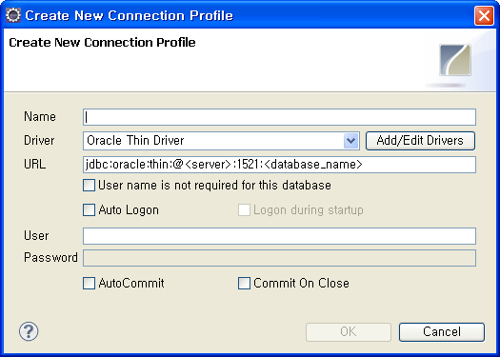
SQL Explorer
Profile
Name: Local Oracle
URL: jdbc:oracle:thin:@localhost:1521:orcl
User: scott
Password: tiger

Slide 8
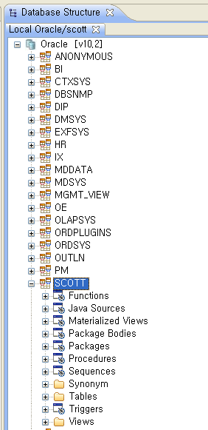
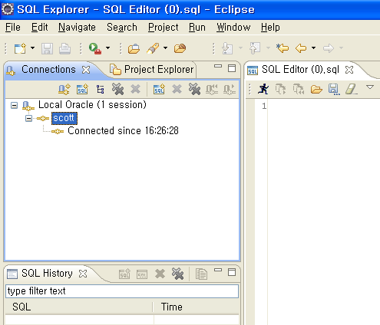
SQL Explorer
Profile
Left Pan
  Click Session
Right Pan
  Click Schema

